Slide 1
PROF -- DR. SK. DWIWEDY BY NAME -RISHABH SALUJA Roll no.- 224103426
LOGISTIC MAPS AND SYNCHRONIZATION

Slide 2
abstract
Chaotic systems are frequently encountered in nature. Their continued discovery imparts relevance to the effort being made to understand the behavior of chaotic dynamics. The wide occurrence of chaos in nature shows that the chaos found in many simple mathematical models is not a trite ancillary mathematical effect but adumbrates a profound natural phenomenon. The logistic map (LM) is frequently cited as one such simple model capable of exhibiting chaotic behavior and is used widely as a pedagogical tool. It provides a proverbial stepping stone toward expanding our understanding of the path dynamical systems take toward chaos. Also, the 2-D LM serves as a convenient tool for studying the synchronization behavior encountered frequently in coupled chaotic systems. Complete synchronization can be shown to occur in the coupled logistic map for certain values of the coupling constant. Furthermore, intermittent synchronization precedes the onset of complete synchronization. Analytic techniques can be used to precisely determine the onset of complete synchronization. A general analytic method, however, for predicting regions of synchronization remains to be found

Slide 3
INTRODUCTION
The ubiquity of chaos in the natural world has given rise to a plentitude of fascinating science. Phenomenologically inherent to many naturally occurring systems, chaotic dynamics are encountered on the microscopic scale as well as the macroscopic scale. From the rotation of several gravitationally attracted large bodies, to the dynamics of viscous flow or population growth, chaos is widely prevalent. The importance of understanding the origin and behavior of chaos is incontrovertible; and though a relatively new science there already exists a wealth of literature on the topic.
Chaos is explored by means of the deceptively simple logistic map(LM). Often cited as a canonical example of chaotic behavior and used frequently solely for didactic purposes, the LM is a natural model useful in a variety of applications. The logistic equation from which the LM originates is an ordinary differential equation introduced first as a demographic model in 1838 by Pierre Francois Verhulst . One arrives at the typical form of the logistic equation from Verhults’ by a series of simple variable.

Slide 4
The deeper ramifications of the logistic model, specifically its chaotic behavior, were reviewed in a seminal paper by the biologist Robert May in 1976 . Indeed, numerical and analytical efforts to understand the behavior of the LM have continued steadily since that time. The happy advent of computers has provided an invaluable tool for insight into chaotic dynamics. The present paper provides a summary and extension of a few of the many results related to the LM.
Characterization of Synchronization in Chaotic Maps
The trajectories of the LM in the chaotic regime can conveniently be thought of as chaotic oscillations. This paradigm lends itself to a characterization of synchronization based on the properties of waves. We may use frequency, amplitude, and phase, to quantify the behavior of the trajectories which may in turn be used to identify synchronization: If the phase, amplitude and frequency agree in a coupled system, the system will exhibit complete synchronization (CS). Since we are dealing with chaotic oscillations, there is no well defined frequency, phase, or amplitude. A mean frequency, mean phase, and mean amplitude must be defined

Slide 5
Verhults equation
The logistic equation was written in the following form by Verhulst in his population model published in 1845.
dN/dt = rN(K − N)/K
Here r is called the Malthusian parameter, and K is referred to as the carrying capacity— to see why, simply let N go to K,
dN/dt = rN(K − K)/K ≡ 0
Thus, when N equals K the population growth is zero and is at a maximum. The logistic equation, however, is most often written in a different form by letting x → N/K,
kdx dt = rx(1 − x)
Then redefining r by r → r/K,
dx/dt = rx(1 − x)
dot x= rx(1 − x)
Sigmoid curves have introduced the common notation,
dotx = dx/dt.
As a result of the rescaling, x is now between 0 and 1. Further, r (called the biotic constant or potential) represents the largest possible value of growth.

Slide 6
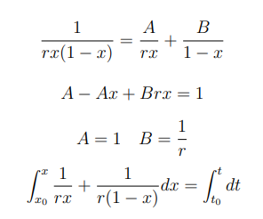
SIGMOID CURVE
With this form of the logistic equation as a starting point, the a
familiar sigmoid solutions are readiably obtainable;
dx/dt = rx(1 − x)
Using the partial fractions method, this is easily separable and integrable
For convenience and without loss of generality, let t0 = 0:

Slide 7
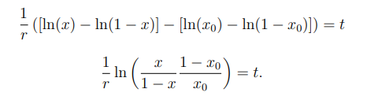
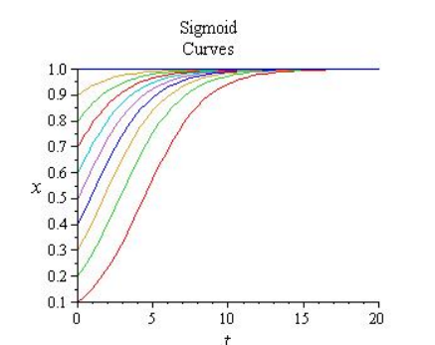

for x takes a little algebra but gives the following result:
Functions of this form are called sigmoid functions.

Slide 8
LOGISTIC MAP
In the case of the logistic map, we can calculate the fixed points as a function of the parameter r by noting that the condition xn+a = xn must be satisfied and by substituting into the mapping function. When a = 1 we have,
xn = rxn(1 − xn)
We may write this without the subscripts and solve for x,
x = rx(1 − x) → x(1 − r + rx)
x = 0, (r − 1 )/r
Notice that the non-zero root verifies the result presented in Chapter 1 from the exact solution, namely that the trajectories converge to 1/2 when r = 2.
For the a = 2 case we get a quartic equation resulting in two separate stationary points. This is appropriately called a two-cycled attractor because the trajectories oscillate between two stationary points.
x = r(rx(1 − x))(1 − rx(1 − x))
x = 0, (r − 1)/ r , (r + 1 ± √ r 2 − 2r − 3)/ 2r
It is readily seen that (r+1± √ r 2 − 2r − 3)/2r are imaginary until (r−3)(r+1) = 0.
Thus, we should expect to see some behavioral difference in the map at r = 3. Further investigation reveals that, indeed, the stationary point found in the a = 1 case becomes unstable at r = 3, while the newly found a = 2 roots are stable. The change from a single stationary point to two results in a bifurcation. The a = 1 root is plotted with the a = 2 roots

Slide 9
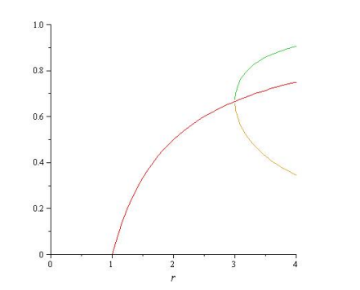
The first bifurcation of the logistic map occurs at r = 3. The first root becomes unstable at this point.
The zeroth iteration yields roots that are solutions to a general iteration (all numbers are multiples of one) whereas roots of an nth iteration are solutions only to m × nth iterations where m is a positive integer value.

Slide 10
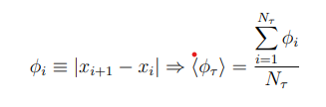
CHARACTERIZATION OF SYNCHRONIZATION IN CHAOTIC MAPS
A mean frequency, mean phase, and mean amplitude must be defined.
Mean frequency
By defining a mean frequency we partially characterize the oscillations,
f= Nτ/τ
where Nτ is the number of cycles within a time τ . Two systems with identical (or near to it) mean frequencies are defined to be frequency synchronized.
Mean Phase
Analogous to the definition of a mean frequency, we can define the mean phase for two oscillating trajectories.
xi correspond to the x-values of local maxima. Two systems with equivalent mean phase or a constant difference in phase are phase synchronized. Note also that φi = const. ∀ i when the oscillations are a sine, cosine, or triangle wave.

Slide 11
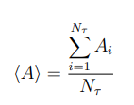
Mean amplitude
Amplitude, phase, and frequency completely define an oscillation. Using a mean amplitude defined to be
we can completely characterized the oscillations. As in the previous two cases, Amplitude synchronization occurs when the mean amplitude is identical in the coupled systems. Note also that by virtue of their respective definitions, the mean amplitude and phase should be qualitatively similar

Slide 12
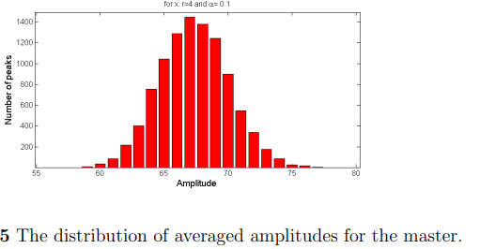
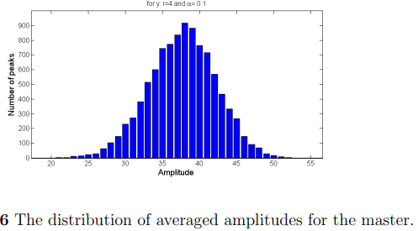
INTERMITTENT SYNCHRONIZATION
To analyze the region of intermittent amplitude synchronization in greater detail requires we first find the distribution of amplitudes in the CLM. Amplitudes are averaged over lengths of time τ for some large number n of iterations and are then counted. For τ = 100 and n = 1 × 104 , the gaussian-like distribution, 4.5 is obtained for the master. The slave similarly exhibits gaussian behavior. The width of the slave
distribution, however, is considerably larger indicating a greater range of amplitudes in the oscillations. Using the distributions of amplitudes, intermittent synchronization is defined to begin when the maximum of the slave-distribution first corresponds to the maximum of the master-distribution, that is, when the most probable value in the distribution of the slave is equivalent to the most probable amplitude of the master.

Slide 13
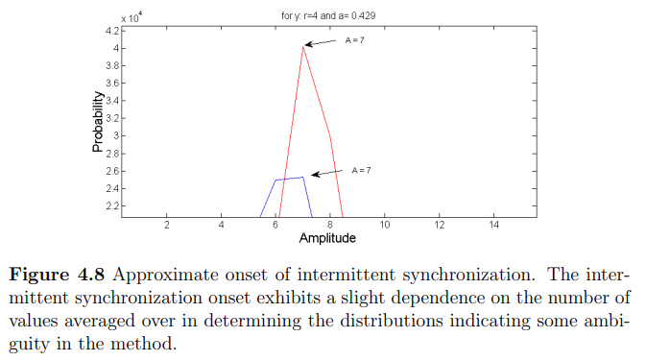
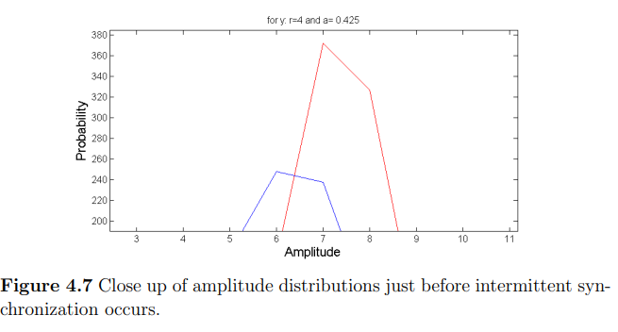
The CLM becomes completely synchronized at a = 0.5, and thus it is of interest to look at the amplitude distributions near this value. Demonstrate the onset of intermittent amplitude synchronization occurring approximately at a = 0.425. It is important to note that synchronization is largely dependent upon its definition. Although there exists a precise point at which complete synchronization occurs (one-to-one correspondence between trajectories), the behaviors individual time averaged frequencies, phases, and amplitudes vary notably. Furthermore, these quantities were only obtained by averaging non-convergent values over long time scales. Thus, the quantitative behavior naturally depends somewhat on Nτ . Qualitative behavior remains largely unchanged, however, and the prediction of complete synchronization is independent of Nτ .
Due to this dependence on Nτ , the physical significance of any solitary synchronization onset is questionable. Whether or not the early onset of frequency synchronization or the intermittent amplitude synchronization as defined in this section can be observed physically is unknown.

Slide 14
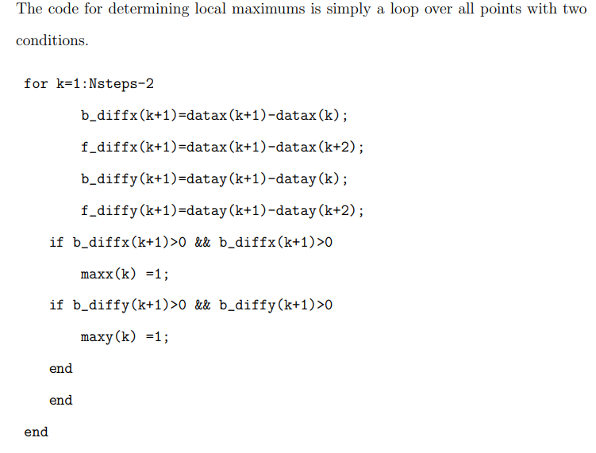
MATLAB CODE FOR DETERMINING LOCAL MAXIMA

Slide 15
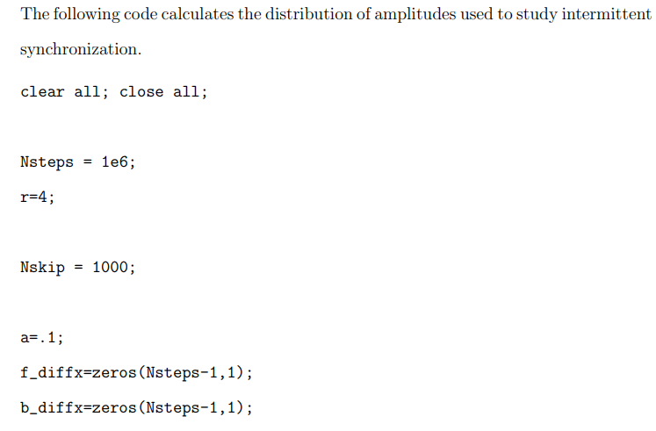

Slide 16
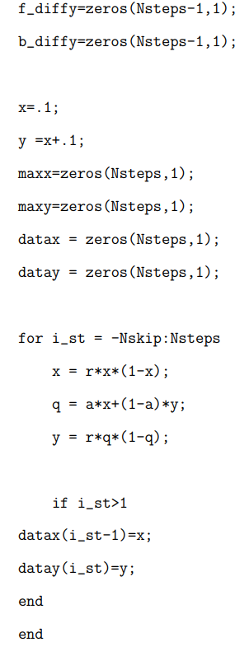
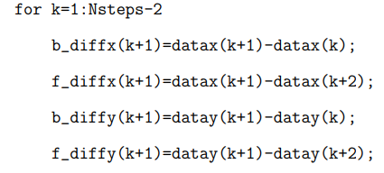

Slide 17
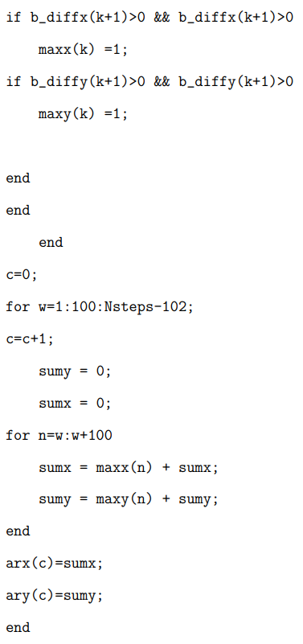
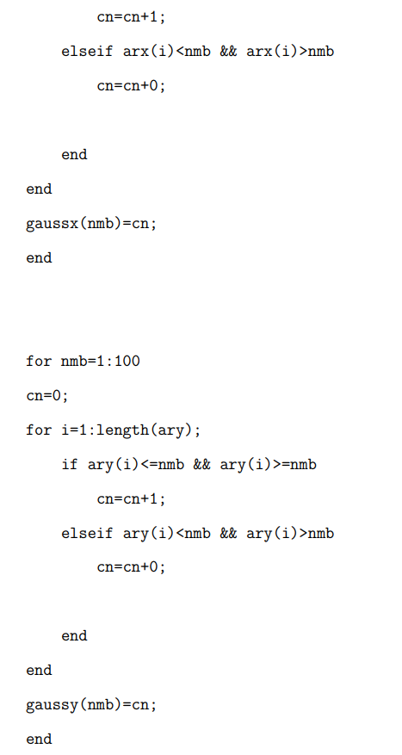
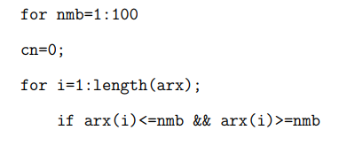

Slide 18
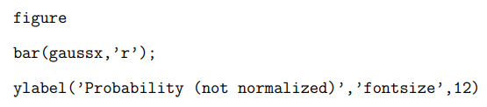
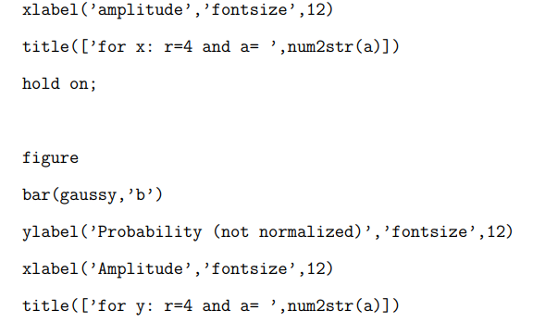

Slide 19
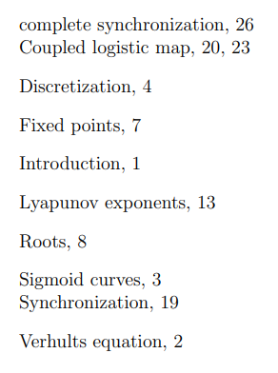
CONCLUSION FROM THE ABOVE CODE THE FOLLOWING RESULT OBTAINED ARE

Slide 20
BIBLIOGRAPHY
[1] P.-F. Verhulst, “Recherches mathmatiques sur la loi d’accroissement de la population,” ouv. mm. de l’Academie Royale des Sci. et Belles-Lettres de Bruxelles 18, 1–41 (1845)
[2] R. M. May, “Simple mathematical models with very complicated dynamics,” Nature 261 (1976).
[3] S. Wolfram, A New Kind of Science (Wolfram Media, Champaign, IL, 2002), p. 1098.
[4] S. N. Rasband, Chaotic Dynamics of Nonlinear Systems (Wiley, New York, 1990).
[5] G. Tancredi, A. S´anchez, and F. Roig, “A comparison between methods to compute Lyapunov exponents,” The Astronomical Journal 121, 11
[6] C. Li and G. Chen, “Estimating the Lyapunov exponents of discrete systems,” Chaos 14 (2004).

Slide 21
THANK YOU
DR. SANTOSH KUMAR DWIWEDY

